Slide 1
SQL PROJECT
IPL Auction Strategy

Slide 2
Data Importing and Table Creation
1. Creation of player_data table to import data from IPL_Ball CSV file.
QUERY : CREATE TABLE player_data(id int,inning int,over int,ball int,batsman varchar(250),non_strike varchar(250),bowler varchar(250),batsman_runs int,extra_runs int,total_runs int,is_wicket int,dismissal_kind varchar(250),player_dismissed varchar(250),fielder varchar(250),extras_type varchar(250),batting_team varchar(250),bowling_team varchar(250));
2. Importing IPL Ball Data from the IPL_Ball CSV file to player_data table in pgadmin.
QUERY : COPY player_data FROM ‘C:\Program Files\PostgreSQL\16\data\Data_copy\IPL_Ball.csv ‘DELIMITER ‘,’CSV HEADER;
3. Creation of match_data table to import data from IPL_matches CSV file.
QUERY : CREATE TABLE match_data(id int,city varchar(255),date varchar(255),player_of_match varchar(255),venue varchar(255),neutral_venue varchar(255),team1 varchar(255),team2 varchar(255),toss_winner varchar(255),toss_decision varchar(255),winner varchar(255),result varchar(255),result_margin int,eliminator varchar(255),method varchar(255),umpire1 varchar(255),umpire2 varchar(255));
4.Importing IPL match data from the IPL_matches CSV file to match_data table in pgadmin
QUERY : COPY match_data FROM ‘C:\Program Files\PostgreSQL\16\data\Data_copy\IPL_matches.csv’
DELIMITER ‘,’CSV HEADER;

Slide 3
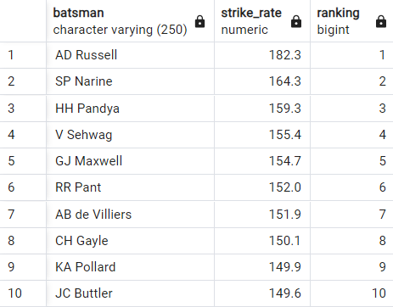
Bidding on Batsman
Q 1. Your first priority is to get 2-3 players with high S.R who have faced at least 500 balls.And to do that you have to make a list of 10 players you want to bid in the auction so that when you try to grab them in auction you should not pay the amount greater than you have in the purse for a particular player.
Query : select batsman,strike_rate,dense_rank()over(order by a.strike_rate desc) as ranking
from (select batsman,round(((sum(batsman_runs)::float /count(ball)::float)*100)::decimal,1) as strike_rate from player_data where not extras_type ='wides' group by batsman having count(ball)>500 order by strike_rate desc limit 10) as a;
NOTE : While calculating Strike Rate of a batsman a wide ball is not counted as a ball faced neither the run is counted into the batsman’s score.

Slide 4
Top 10 fast run getters to aim for in the auction:

Slide 5
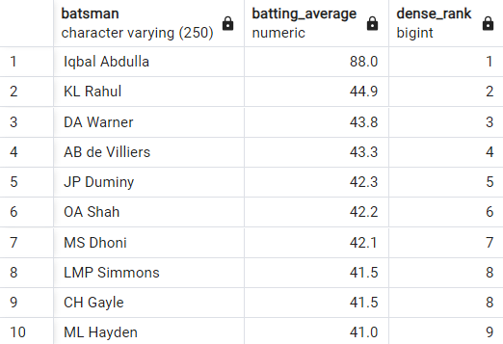
Q 2. Now you need to get 2-3 players with good Average who have played more than 2 ipl seasons. And to do that you have to make a list of 10 players you want to bid in the auction so that when you try to grab them in auction you should not pay the amount greater than you have in the purse for a particular player.
Query : select batsman,batting_average,dense_rank()over(order by batting_average desc)
from(select batsman,round(avg(((total_runs::float /times_dismissed::float)))::decimal,1) as batting_average from( select batsman,sum(batsman_runs) as total_runs,sum(player_out) as times_dismissed,count(distinct (right(date,4)))as seasons_played from(select match_data.date,player_data.batsman,player_data.batsman_runs,player_data.is_wicket,case when is_wicket=1 and player_data.batsman=player_data.player_dismissed then 1 else 0 end as player_out from player_data full join match_data on player_data.id=match_data.id) as t1 group by batsman) as t2 group by batsman,total_runs,times_dismissed,seasons_played having times_dismissed>=1 and seasons_played>2 order by batting_average desc)as t3 limit 10;
NOTE : While calculating the total number of times a batsman has been dismissed we have to be careful with “run outs” because even if the player is on strike and there is a wicket it is not certain he is out maybe the non striker has been run out.

Slide 6
Top 10 batsman with good batting average:

Slide 7
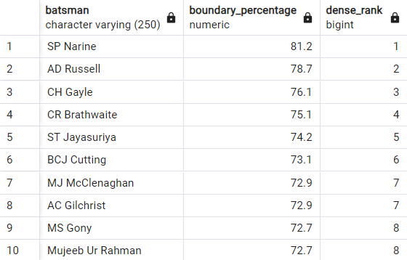
Q 2. Now you need to get 2-3 Hard-hitting players who have scored most runs in boundaries and have played more the 2 ipl season. To do that you have to make a list of 10 players you want to bid in the auction so that when you try to grab them in auction you should not pay the amount greater than you have in the purse for a particular player.
Query : select batsman,boundary_percentage,dense_rank()over(order by boundary_percentage desc) from(select batsman,round(((runs_in_boundary::float/total_runs::float)*100)::decimal,1) as boundary_percentage from(select batsman,sum(batsman_runs) as total_runs,sum(boundary_runs)as runs_in_boundary,count(distinct (right(date,4)))as seasons_played
from(select match_data.date,player_data.batsman,player_data.batsman_runs,case when player_data.batsman_runs=4 then 4 when player_data.batsman_runs=6 then 6 else 0 end as boundary_runs from player_data full join match_data on player_data.id=match_data.id) as t1 group by batsman)as t2 group by batsman,total_runs,runs_in_boundary,seasons_played having seasons_played>2 order by boundary_percentage desc)as t3 limit 10;

Slide 8
Top 10 batsman with best boundary percentage:

Slide 9
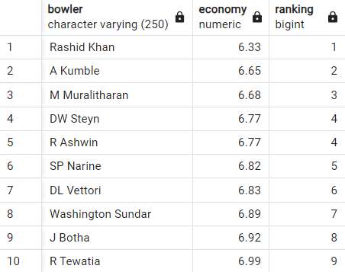
Bidding on Bowlers
Q 1. Your first priority is to get 2-3 bowlers with good economy who have bowled at least 500 balls in IPL so far.To do that you have to make a list of 10 players you want to bid in the auction so that when you try to grab them in auction you should not pay the amount greater than you have in the purse for a particular player.
Query : select bowler,economy,dense_rank()over(order by a.economy asc)as ranking
from(select bowler,round((sum(total_runs)::float/(count(ball)::float/6))::decimal,2)as economy from player_data group by bowler having count(ball)>=500 order by economy asc limit 10)as a;

Slide 10
Top 10 bowlers with best economy rate:

Slide 11
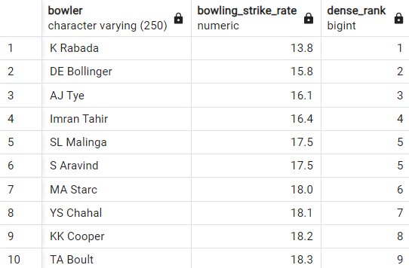
Q 2. Now you need to get 2-3 bowlers with the best strike rate and who have bowled at least 500 balls in IPL so far.To do that you have to make a list of 10 players you want to bid in the auction so that when you try to grab them in auction you should not pay the amount greater than you have in the purse for a particular player.
Query : select bowler,bowling_strike_rate,dense_rank()over(order by bowling_strike_rate asc)
from(select bowler,round(avg(((total_balls::float /times_dismissed::float)))::decimal,1) as bowling_strike_rate from( select bowler,count(ball) as total_balls,sum(player_out) as times_dismissed from(select bowler,ball,is_wicket,case when is_wicket=1 and not dismissal_kind='run out' then 1 else 0 end as player_out from player_data ) as t1 group by bowler) as t2 group by bowler,total_balls,times_dismissed having times_dismissed>0 and total_balls>=500 order by bowling_strike_rate asc)as t3 limit 10;
NOTE : While calculating the total number of wickets taken by a bowler run out is not counted as wicket clinched by the bowler hence run outs has to be excluded in our calculation.

Slide 12
Top 10 bowlers with best strike rate:

Slide 13
Bidding on All Rounders
Q 1. Now you need to get 2-3 All_rounders with the best batting as well as bowling strike rate and who have faced at least 500 balls in IPL so far and have bowled minimum 300 balls.To do that you have to make a list of 10 players you want to bid in the auction so that when you try to grab them in auction you should not pay the amount greater than you have in the purse for a particular player.
Query : select a.batsman as all_rounder,a.batting_strike_rate,b.bowling_strike_rate
from (select batsman,round(((sum(batsman_runs)::float /count(ball)::float)*100)::decimal,1) as batting_strike_rate from player_data where not extras_type ='wides' group by batsman having count(ball)>500 order by batting_strike_rate desc) as a inner join (select bowler,round(avg(((total_balls::float /times_dismissed::float)))::decimal,1) as bowling_strike_rate
from( select bowler,count(ball) as total_balls,sum(player_out) as times_dismissed
from(select bowler,ball,is_wicket,case when is_wicket=1 and not dismissal_kind='run out' then 1 else 0 end as player_out from player_data ) as t1 group by bowler) as t2 group by bowler,total_balls,times_dismissed having times_dismissed>0 and total_balls>=300 order by bowling_strike_rate asc) as b on a.batsman=b.bowler where batting_strike_rate>=130 and bowling_strike_rate<=24 limit 10;
NOTE : While calculating sum of balls faced ,wides is not considered for a batsman and also in case of run out wicket is not counted in bowler’s account so we have to be very careful with these cricketing constraints .

Slide 14
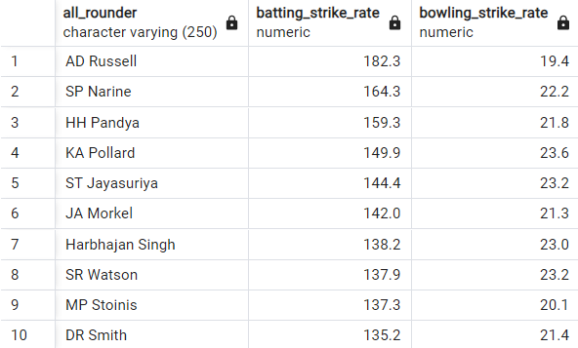
Top 10 All rounders with best bowling and batting S/R:

Slide 15
Bidding on Wicket Keepers
CRITERIA : 1. He should have played more than 2 ipl seasons.
2. He should have a good batting strike rate.
3. He should have done more than 5 stumpings in the ipl.
4. He should have taken more than 40 catches in his ipl career.
Query : select a.batsman as wicket_keeper,a.strike_rate,b.catches_taken,dense_rank()over(order by a.strike_rate desc)as ranking from (select batsman,round(((sum(batsman_runs)::float /count(ball)::float)*100)::decimal,1) as strike_rate from player_data where not extras_type ='wides' group by batsman having count(ball)>500 order by strike_rate desc)as a
inner join(select t1.fielder,sum(t1.stumping_count) as stumped_count,sum(t1.catches_taken)as catches_taken,count(distinct (right(t1.date,4)))as seasons_played
from(select match_data.date,player_data.fielder,case when dismissal_kind='stumped' then 1 else 0 end as stumping_count,case when dismissal_kind='caught' then 1 else 0 end as catches_taken
from player_data full join match_data on player_data.id=match_data.id ) as t1 group by fielder
having count(distinct (right(t1.date,4)))>2 and sum(t1.stumping_count)>5 and sum(t1.catches_taken)>40 order by catches_taken desc ,stumped_count desc)as b on a.batsman=b.fielder order by a.strike_rate desc limit 10;
NOTE : While analyzing wicket keepers the important thing is that he should have done wicket keeping before which can only be confirmed by counting the number of stumpings the player has done ,following which he or she should have good batting strike rate because wicket keepers hardly bowl.

Slide 16
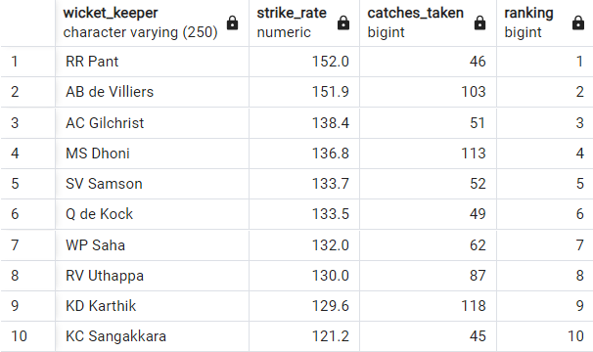
Top 10 Wicket Keepers with good batting S/R:

Slide 17
Additional Questions
1. Creation of deliveries table to import data from IPL_Ball CSV file.
QUERY : CREATE TABLE deliveries(id int,inning int,over int,ball int,batsman varchar(250),non_strike varchar(250),bowler varchar(250),batsman_runs int,extra_runs int,total_runs int,is_wicket int,dismissal_kind varchar(250),player_dismissed varchar(250),fielder varchar(250),extras_type varchar(250),batting_team varchar(250),bowling_team varchar(250));
2. Importing IPL Ball Data from the IPL_Ball CSV file to player_data table in pgadmin.
QUERY : COPY deliveries FROM ‘C:\Program Files\PostgreSQL\16\data\Data_copy\IPL_Ball.csv ‘DELIMITER ‘,’CSV HEADER;
3. Creation of matches table to import data from IPL_matches CSV file.
QUERY : CREATE TABLE matches(id int,city varchar(255),date varchar(255),player_of_match varchar(255),venue varchar(255),neutral_venue varchar(255),team1 varchar(255),team2 varchar(255),toss_winner varchar(255),toss_decision varchar(255),winner varchar(255),result varchar(255),result_margin int,eliminator varchar(255),method varchar(255),umpire1 varchar(255),umpire2 varchar(255));
4.Importing IPL match data from the IPL_matches CSV file to match_data table in pgadmin
QUERY : COPY matches FROM ‘C:\Program Files\PostgreSQL\16\data\Data_copy\IPL_matches.csv’
DELIMITER ‘,’CSV HEADER;

Slide 18


Q 1. Get the count of cities that have hosted an IPL match .
Query : select count(city) from matches;
Query : select count(distinct city )from matches;

Slide 19
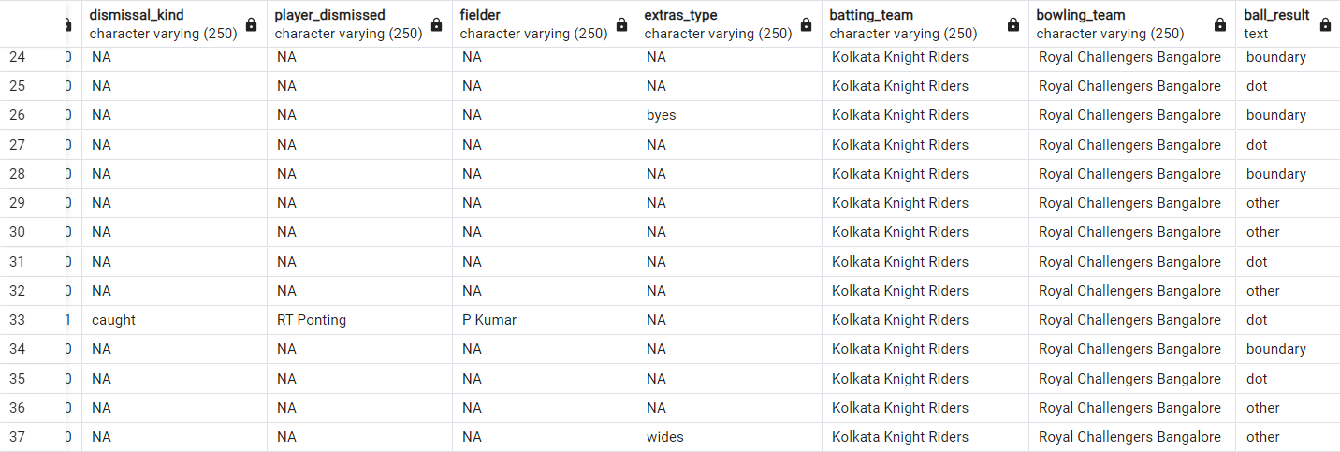
Q 2. Create table deliveries_v02 with all the columns of the table ‘deliveries’ and an additional column ball_result containing values boundary, dot or other depending on the total_run (boundary for >= 4, dot for 0 and other for any other number) (Hint 1 : CASE WHEN statement is used to get condition based results) (Hint 2: To convert the output data of the select statement into a table, you can use a subquery. Create table table_name as [entire select statement].
Query : create table deliveries_v02 as(select *,case when total_runs>=4 then 'boundary' when total_runs=0 then 'dot' else 'other' end as ball_result from deliveries);

Slide 20
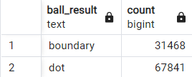
Q 3. Write a query to fetch the total number of boundaries and dot balls from the deliveries_v02 table.
Query : select ball_result,count(ball_result) from deliveries_v02 where ball_result='boundary' or ball_result='dot' group by ball_result;

Slide 21
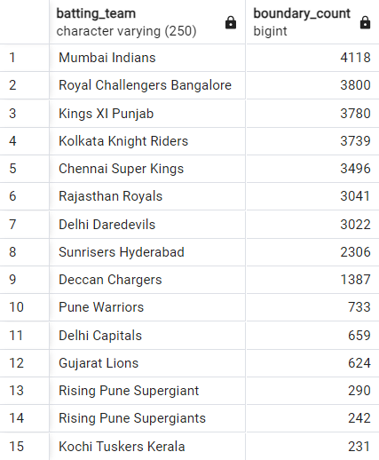
Q 4. Write a query to fetch the total number of boundaries scored by each team from the deliveries_v02 table and order it in descending order of the number of boundaries scored.
Query : select batting_team,count(ball_result) as boundary_count from deliveries_v02 where ball_result='boundary' group by batting_team order by boundary_count desc;

Slide 22
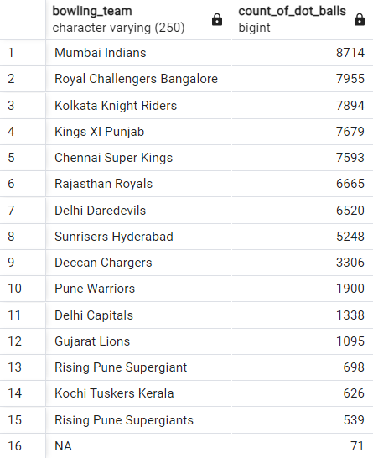
Q 5. Write a query to fetch the total number of dot balls bowled by each team and order it in descending order of the total number of dot balls bowled.
Query : select bowling_team,count(ball_result) as count_of_dot_balls from deliveries_v02 where ball_result='dot' group by bowling_team order by count_of_dot_balls desc;

Slide 23
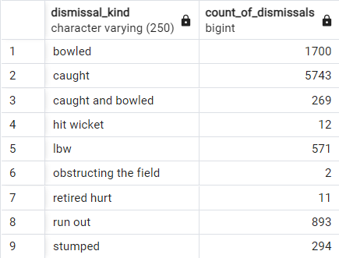
Q 6. Write a query to fetch the total number of dismissals by dismissal kinds where dismissal kind is not NA.
Query : select dismissal_kind,count(dismissal_kind)as count_of_dismissals from deliveries_v02 where not dismissal_kind='NA' group by dismissal_kind;

Slide 24
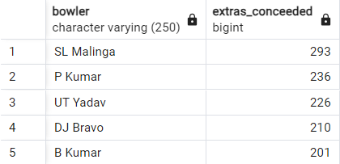
Q 7. Write a query to get the top 5 bowlers who conceded maximum extra runs from the deliveries table.
Query : select bowler,sum(extra_runs) as extras_conceeded from deliveries_v02 group by bowler order by extras_conceeded desc limit 5;

Slide 25
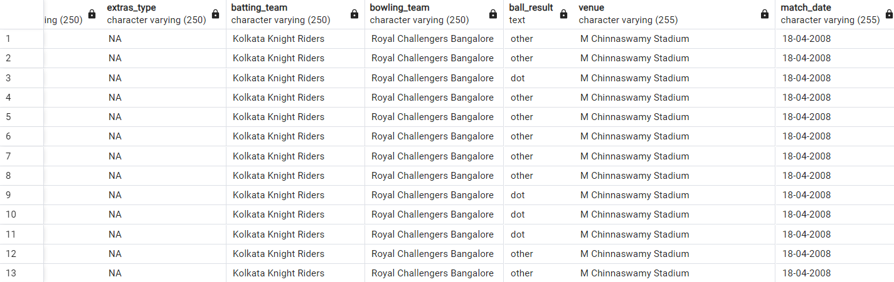
Q 8. Write a query to create a table named deliveries_v03 with all the columns of deliveries_v02 table and two additional column (named venue and match_date) of venue and date from table matches .
Query : create table deliveries_v03 as(select deliveries_v02.*,matches.venue,matches.date as match_date from deliveries_v02 full join matches on deliveries_v02.id=matches.id);

Slide 26
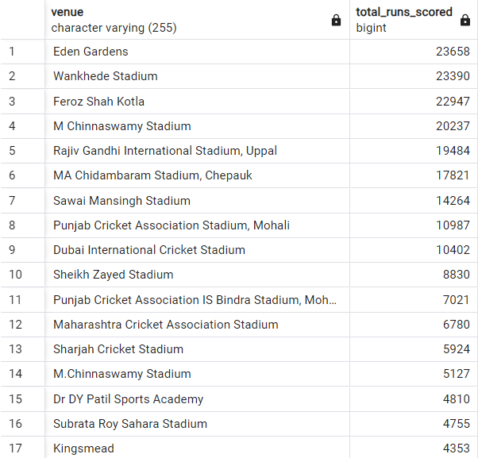
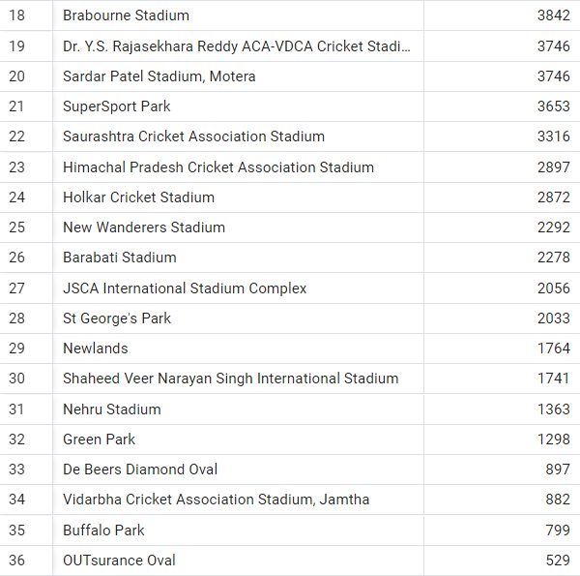
Q 9. Write a query to fetch the total runs scored for each venue and order it in the descending order of total runs scored.
Query : select venue,sum(total_runs) as total_runs_scored from deliveries_v03 group by venue order by total_runs_scored desc;

Slide 27
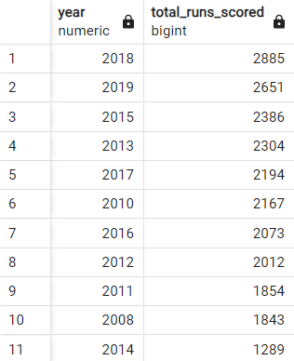
Q 10. Write a query to fetch the year-wise total runs scored at Eden Gardens and order it in the descending order of total runs scored.
Query : select extract(year from (to_date(match_date,'DD-MM-YYYY'))) as year,sum(total_runs) as total_runs_scored from deliveries_v03 where venue='Eden Gardens' group by year order by total_runs_scored desc;

